Slide 1
STOR 455 Review for Final Exam

Slide 2
Final Exam
30% of Course Grade
Cumulative and covers the entire semester
Answer MC questions in class through Gradescope
Class on Thursday as a review class.

Slide 3
Summary of Extra Credit Opportunities
Picking my math mistakes (not English typos or grammar mistakes) on slides and the blackboard. 0.5% each.
Finishing the course evaluation and forwarding me the confirmation. 1%.
Individual project on wrong linear models by April 29th. 1%.
Group project on movie box office prediction by April 19th.
Prediction competition: up to 1%.
Data collection and Analysis: 1%.
Will grade the analysis and post the spreadsheet of predictions this weekend.
Extra credit homework: 2%. Due April 30th.

Slide 4
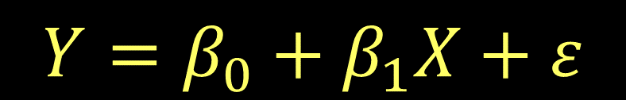
Multiple Regression Model
$$Y=β_{0}+β_{1}X_{1}+β_{2}X_{2}+⋯β_{k}X_{k}+ε$$
$$Y=β_{0}+β_{1}X+ε$$
k predictors
where ε ~ N( 0, σ_{ε}) and independent
Data?
We need n data cases, each with values for Y and all of the predictors X₁,...,X_{k}.

Slide 5
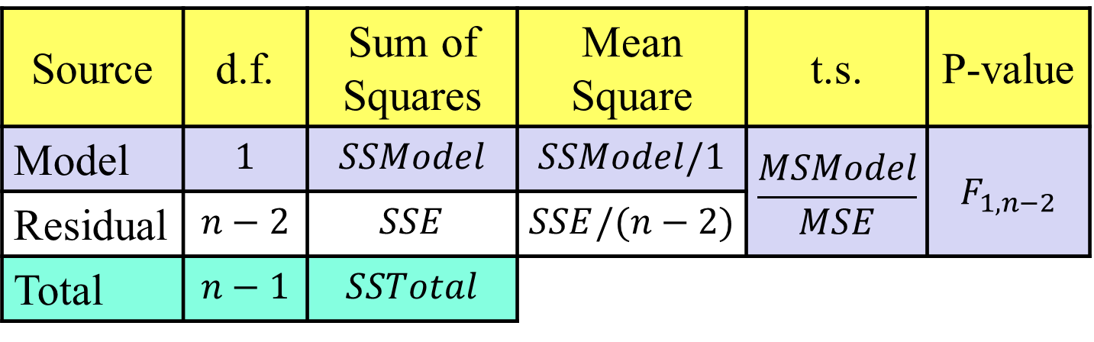
ANOVA test for Overall Fit
weak model
H_{o}: β₁= β₂=...=β_{k}= 0
H_{a}: Some β_{i} ≠ 0
effective model
Source | d.f. | Sum of Squares | Mean Square | t.s. | P-value
Model | $$1$$ | $$SSModel$$ | $$SSModel/1$$ | $$\frac{MSModel}{MSE}$$ | $$F_{1,n−2}$$
Residual | $$n−2$$ | $$SSE$$ | $$SSE/(n−2)$$
Total | $$n−1$$ | $$SSTotal$$
k
k
F_{k,n-k-1}
n-k-1
(n-k-1)

Slide 6
Coefficient of Multiple Determination
Now interpreted as the % of variability in the response variable (Y) that is “explained” by a linear combination of these predictors.

Slide 7
Example
In studying a multiple regression problem, a student accidentally “doubled” a dataset by recording each observation twice. Which of the following statistic will change?
Slope
Intercept
R squared
F-statistic

Slide 8
Binary Logistic Regression Model
Y = Binary response
X = Quantitative predictor
π = proportion of 1’s (yes, success,…) at any x
Probability form
Logit form
Linear Model

Slide 9
Binary Logistic Regression Model
Y = Binary response
X₁,X₂,…,X_{k} = Multiple predictors
X = Single predictor
π = proportion of 1’s (yes, success) at any x
π = proportion of 1’s at any x₁, x₂, …, x_{k}
Equivalent forms of the logistic regression model:
Logit form
Probability form

Slide 10

G-Test for Overall Fit
(Similar to regression ANOVA455)
H₀:β₁=β₂=…=β_{k}=0 vs. H_{a}: Some β_{i} ≠ 0
t.s. = G = improvement in –2log(L) over a model with just a constant term
Compare to χ² with k d.f.
# predictors
Null deviance: 200.16 on 199 degrees of freedom
Residual deviance: 191.59 on 197 degrees of freedom
$$G=200.16−191.59=8.57$$
1-pchisq(8.57,2)
[1] 0.01377362
Reject H₀

Slide 11
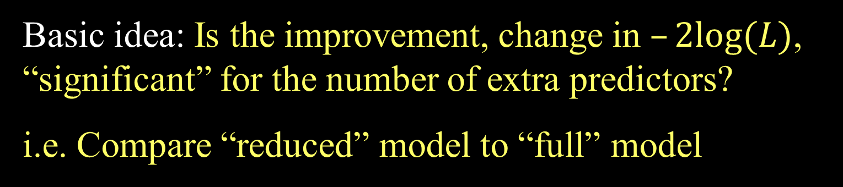
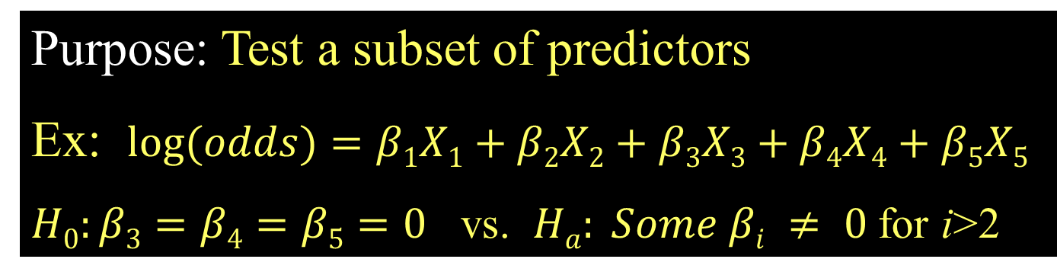
Nested LRT for Logistic Regression (Likelihood Ratio Test)
Purpose: Test a subset of predictors
Ex: $log⁡(odds)=β1X1+β2X2+β3X3+β4X4+β5X5$
$H0:β3=β4=β5=0$ vs. $Ha: Some βi ≠ 0$for i>2
Basic idea: Is the improvement, change in $–2log⁡(L)$, “significant” for the number of extra predictors?
i.e. Compare “reduced” model to “full” model
$χ^{2}=–2log⁡(LReduced) – (–2log⁡(LFull))$
Chi-square d.f.=#extra predictors tested

Slide 12
Bayesian Information Criteria
n : sample size
k : number of predictors
θ : set of all parameters.
L(θ̂) :probability of obtaining the data which you have, supposing the model being tested was a given.
k log(n)- 2log(L(θ̂))
Selection criteria, similar to Mallow’s Cp
Smaller values indicate preferred models

Slide 13
Example
Suppose a logistic regression with 2 continuous predictors and 200 observations has a residual deviance of 173.08. What is the BIC of this model?
2*log(200)+173.08 = 183.67

Slide 14
ANOVA (Means) Model
Mean for Group #i
N(0,σ_{ε}) random error
Under H_{o} (μ_{i}’s all equal) ⇒
(overall mean)
Under H_{a} (μ_{i}’s differ) ⇒
(group mean)

Slide 15
ANOVA Table (for K Group Means)
H_{o}: μ₁ = μ₂= … = μ_{K}
H_{a}: Some μ_{i} ≠μ_{j}
Small P-value ➔ Reject H_{o} ➔ There is a significant difference among the means of the K groups

Slide 16
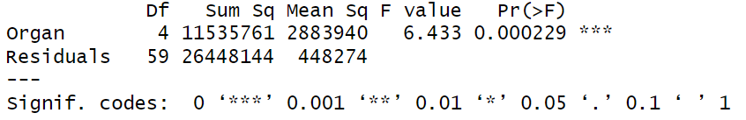
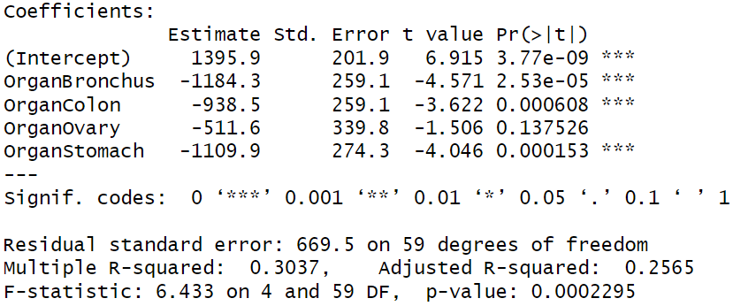
ANOVA for the Mean is a Linear Model!

Slide 17
Problem of Multiplicity
When doing many pairwise comparisons
⇒ likely to make a Type I error (find a false difference)
In the cartoon, even if there is no relationship between the color and acne, the chance of seeing at least one 0.05 significant test out of 20 independent tests is
1-(1-0.05)^20 =64%!
Possible fixes:
Do only a few pre-planned comparisons
Adjust the significance level used for each test.

Slide 18
Two-way ANOVA: Main Effects Model
Grand Mean
Random error
Effect for k^{th} treatment
Effect for j^{th} block

Slide 19
What’s an Interaction Effect?
An interaction effect occurs when a significant difference is present at a specific combination of factors.
Example: Y=GPA
Factor A = Year in School (FY, So, Jr, Se)
Factor B = Major (Psych, Bio, Math)
FY is hard?
⇒ α₁ < 0 (main effect)
Bio is easy?
⇒ β₂ > 0 (main effect)
Jr in Math is hard?
⇒ γ₃₃ < 0 (interaction effect)

Slide 20
Two-way ANOVA Table (with interaction)
Source | d.f. | S.S. | M.S. | t.s. | p-value
Factor A | K-1 | SSA | SSA/(K-1) | MSA/MSE
Factor B | J-1 | SSB | SSB/(J-1) | MSB/MSE
A x B | (K-1)(J-1) | SSAB | SSAB/df | MSAB/MSE
Error | JK(c-1) | SSE | SSE/df
Total | n-1 | SSY
H_{o}: All α_{k} = 0
H_{A}: Some α_{k} ≠ 0
H_{o}: All β_{J} = 0
H_{A}: Some β_{J} ≠ 0
H_{o}: All γ_{kj} =0
H_{A}: Some γ_{kj} ≠ 0

Slide 21
Checking Conditions for ANOVA
Check with residuals
Zero mean:
Always holds for sample residuals
Constant variance:
Plot residuals vs. fits and/or compare std. dev.’s of groups
(Check if some group s_{i} is more than twice another)
Normality:
Histogram/normal plot of residuals
Independence:
Pay attention to data collection

Slide 22
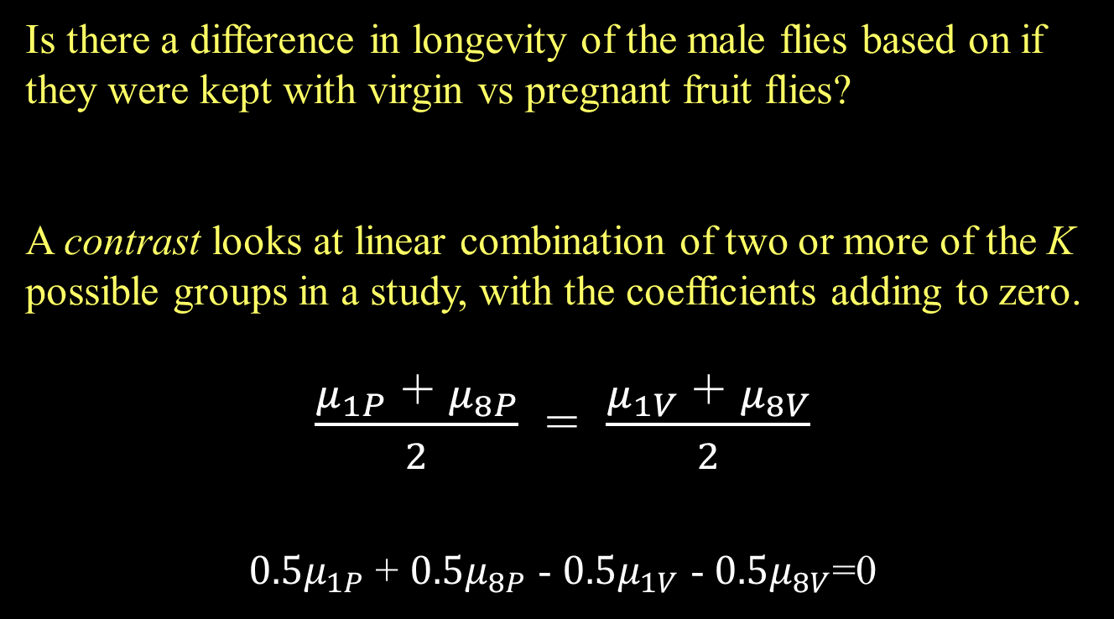
Fruit Flies Contrast
Is there a difference in longevity of the male flies based on if they were kept with virgin vs pregnant fruit flies?
A contrast looks at linear combination of two or more of the K possible groups in a study, with the coefficients adding to zero.
$\frac{μ_{1P}\text{ + }μ_{8P}}{2}$ = $\frac{μ_{1V}\text{ + }μ_{8V}}{2}$
$0.5μ_{1P}$ + $0.5μ_{8P}$ - $0.5μ_{1V}$ - $0.5μ_{8V}$=0
Note: A comparison is a special case of a contrast.

Slide 23
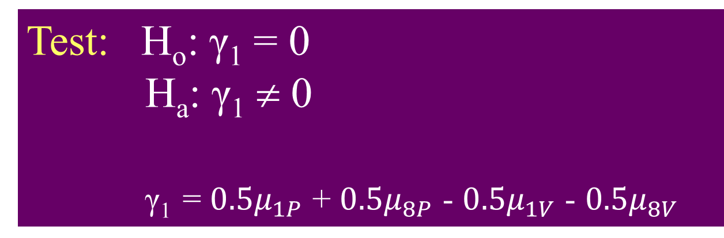
Fruit Fly Contrast
Test: H_{o}: γ₁ = 0
H_{a}: γ₁ ≠ 0
γ₁ = $0.5μ_{1P}$ + $0.5μ_{8P}$ - $0.5μ_{1V}$ - $0.5μ_{8V}$
summary(Fly.mod)
Df Sum Sq Mean Sq F value Pr(>F)
Treatment 4 11939 2984.8 13.61 3.52e-09 ***
Residuals 120 26314 219.3
Fly.MSE = summary(Fly.mod)[[1]][2,3]

